Slide 1

CA4
DEEP LEARNING
PLANT DISEASE DETECTION

Slide 2

Team Members
Siva Kumar CH V ( E0119014 )
Sai Ganesh A ( E0119037 )
Banari Babu B ( E0119029 )
Dileep A ( E0119033 )
Akash Reddy Y ( E0119037 )

Slide 3

Introduction
Table Of Contents
Problem Statement
Dataset Description
Metrics and Loss Function Used
Models
Custom Model
Alex Net
VGG19
GoogleNet
ResNet
Comparison Of Models

Slide 4
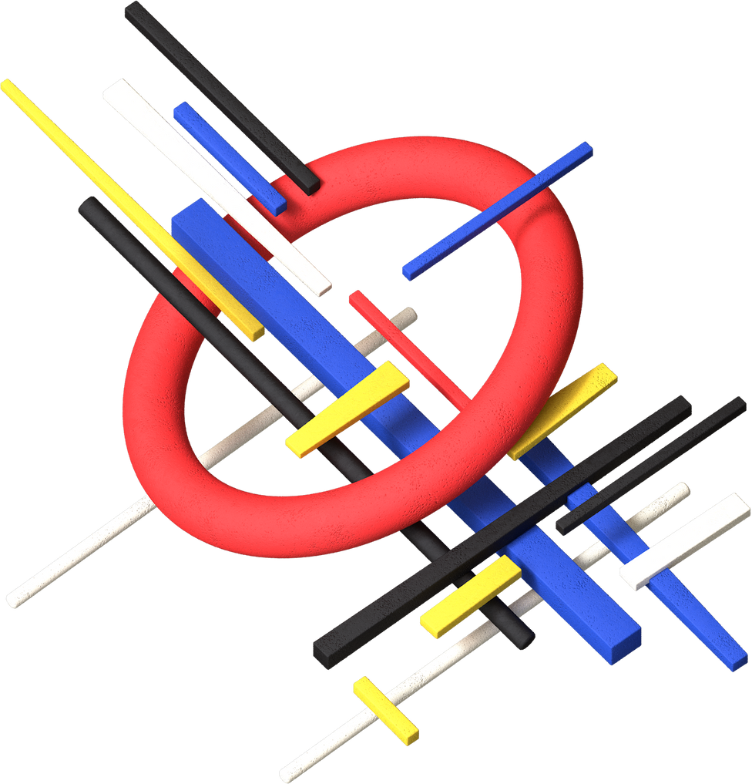
Problem Statement
To detect some commonly occurring diseases in plants

Slide 5

ABOUT DATASET
The Dataset contains 15 directories and total of 20,639 images.
The images span 3 Crop Species : Pepper , Potato , Tomato
The Data set contains 15 classess of crop disease pairs and is listed below :
Pepper Bell Bacterial Spot , Pepper Bell Healthy , Potato Early Blight , Potato Late Blight , Potato Healthy etc ..
Kaggle Link : https://www.kaggle.com/emmarex/plantdisease

Slide 6
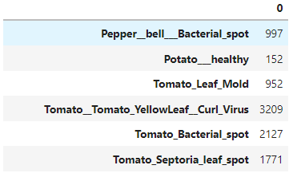
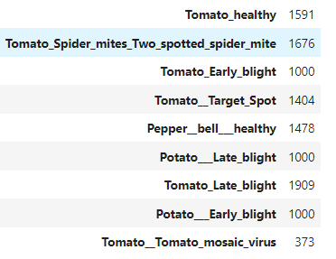
ABOUT DATASET

Slide 7
Metrics Used
Precision
It expresses the proportion of the data points our model says was relevant actually were relevant
Recall
It refers to percentage of total relevant results correctly classified by the model
F1 Score
Weighted Average of precision and Recall

Slide 8
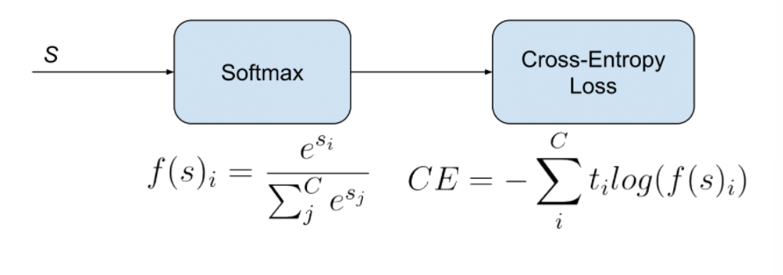
Loss Function :

Slide 9
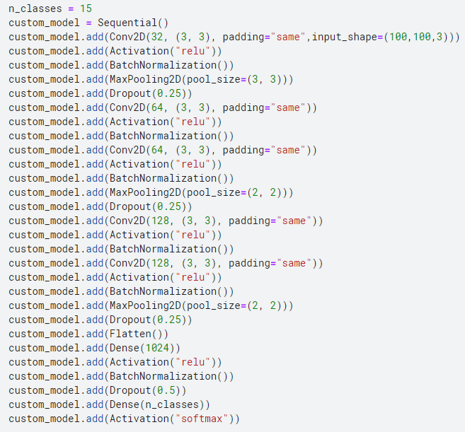
Custom Model

Slide 10
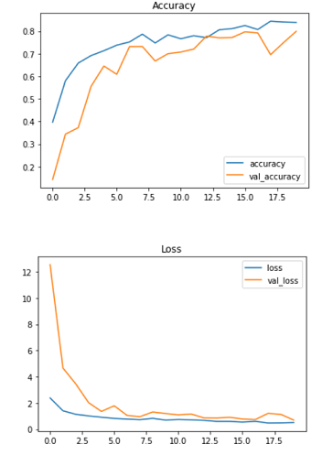
Custom Model
loss : 0.50
Accuracy : 0.83
validation loss : 0.57
validation accuracy : 0.79

Slide 11
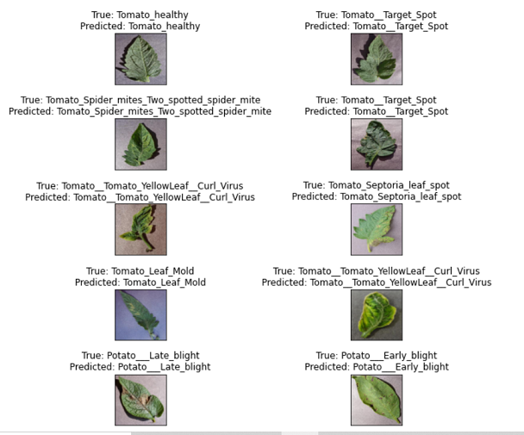
Custom Model Predictions

Slide 12
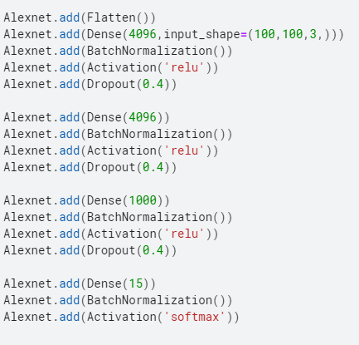
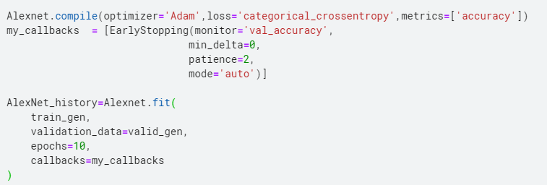
AlexNet

Slide 13
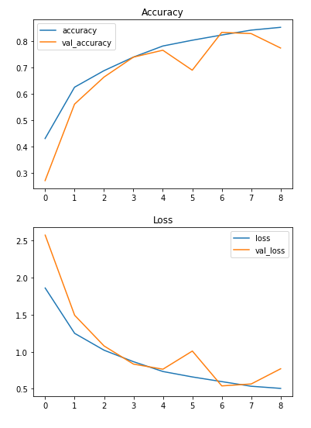
AlexNet
loss : 0.50
Accuracy : 0.78
validation loss : 0.60
validation accuracy : 0.77

Slide 14
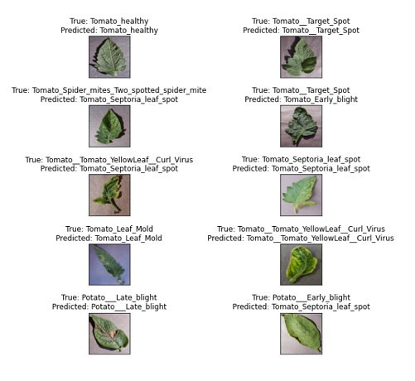
AlexNet Model Predictions

Slide 15
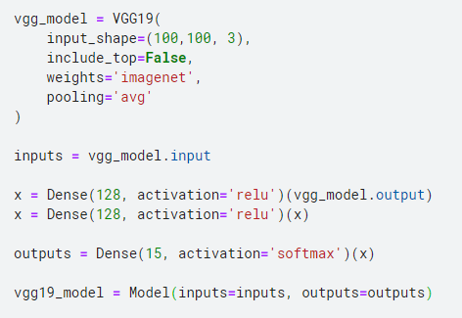
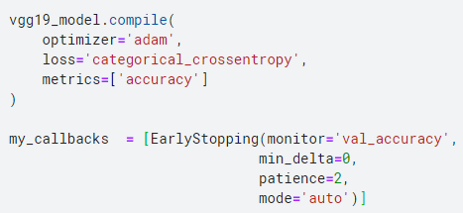
VGG19 Model

Slide 16
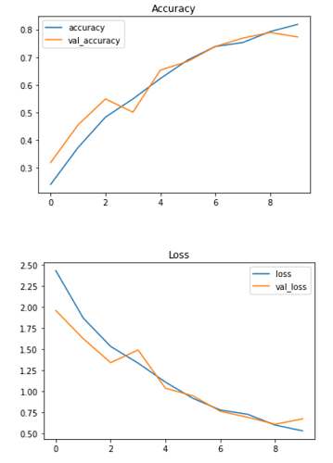
VGG19 and Metrics
loss : 0.65
Accuracy : 0.78
validation loss : 0.67
validation accuracy : 0.77

Slide 17
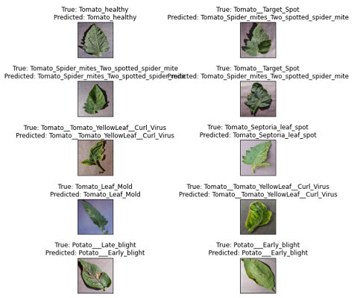
VGG 19 Model Predictions

Slide 18
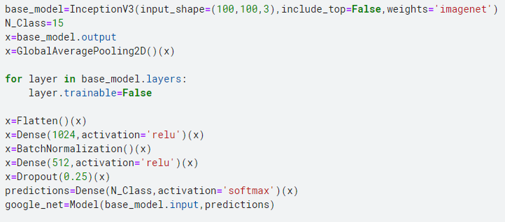
Google Net
GoogLeNet is a 22-layer deep convolutional neural network that’s a variant of the Inception Network, a Deep Convolutional Neural Network
The GoogleNet Architecture is 22 layers deep, with 27 pooling layers included. There are 9 inception modules stacked linearly in total.

Slide 19
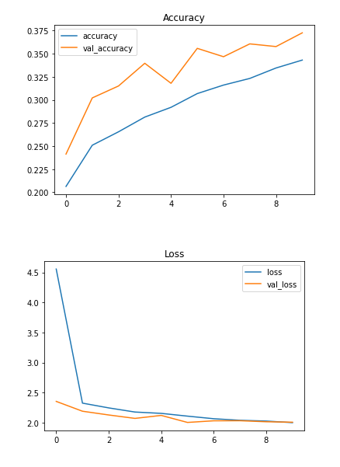
Google Net ( Inception V3 )
loss : 0.65
Accuracy : 0.78
validation loss : 0.80
validation accuracy : 0.71

Slide 20
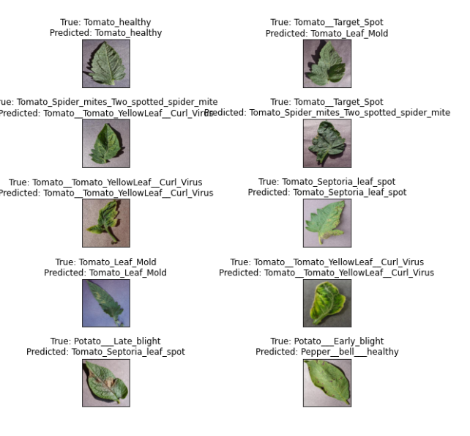
Google Net Model Predictions

Slide 21
ResNet
ResNet, short for Residual Networks is a classic neural network
Skip Connnections technique is introduced in ResNet Model.
Concepts behind ResNet allowed us train models with Deep Network without failing
It helped to overcome the problem of vanishing gradient.

Slide 22
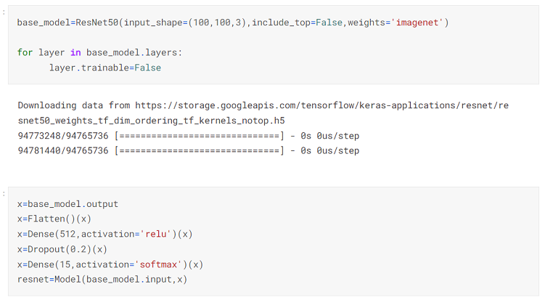
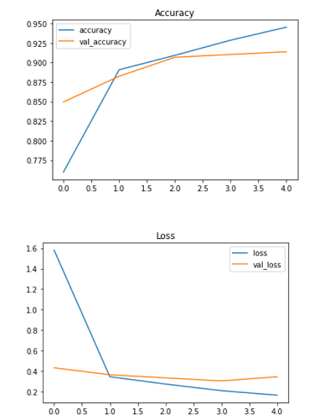
ResNet and Metrics

Slide 23
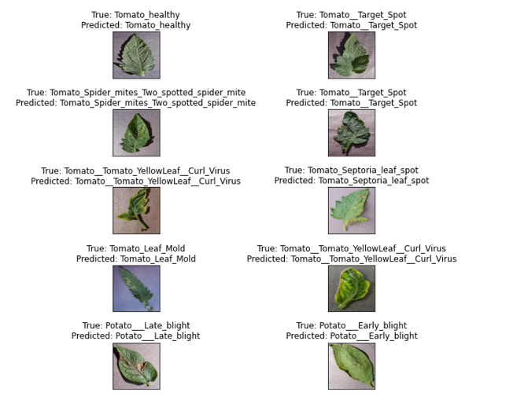
ResNet Model Predictions

Slide 24
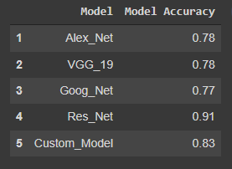
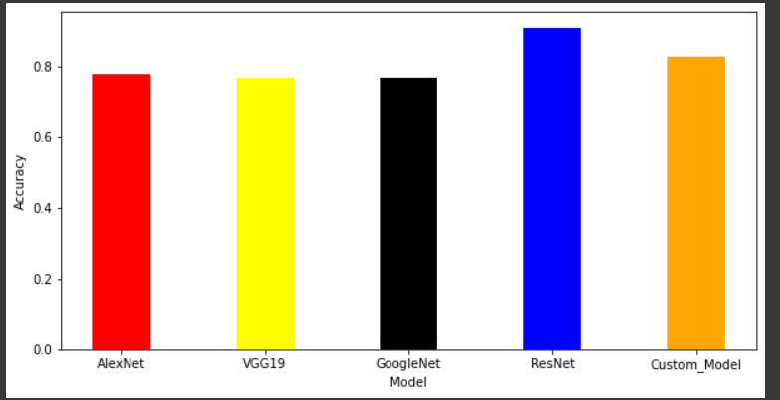
Comparison Of Models

Slide 25
Conclusion
Implemented Deep Learning Model for detection of plant diseases
Out of the 5 models implemented
ResNet Model performed best compared to other

Slide 26

Thank You

